Slide 1
Environmental and spatiotemporal influences on winter ichthyoplankton assemblages of the northern California Current Ecosystem
William R. McCloskey, Luke A. Bobay, Nicholas F. Howard, Robert K. Cowen and Su Sponaugle

Slide 2
Outline
Introduction and background
Sampling and analysis methods
Results and discussion

Slide 3
Introduction and Background

Slide 4
State of LFC knowledge
Current knowledge on LFC
What knowledge gap(s) did we aim to fill? Why this project?
Notes:
WINTER! DEPTH-STRATIFIED!!!

Slide 5
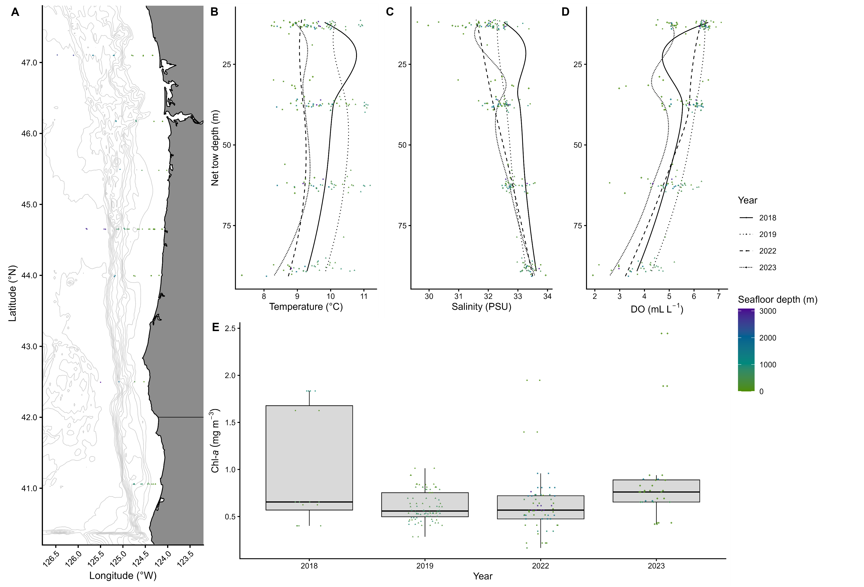
Study area – northern California Current ecosystem
Add fig 1 caption
Notes:
Describe NCC ecosystem and show sampling area

Slide 6
Sampling and Analysis Methods

Slide 7
Sampling and data collection
Describe tows (MOCNESS, when, mesh and mouth size?)
Visual identification of specimens
Environmental sampling
Data filtering/thresholding
Notes:
Describe sampling and identification. Explain collection of environmental covariates. Describe data wrangling (grouping and thresholding)

Slide 8
Data Analyses
Characterizing assemblages
Influences on assemblages
Diel variation in vertical distribution
Cluster analysis
Indicator Species Analysis
NMDS
Distance-based RDA
Permutation-based ANOVA
Variance Partitioning Analysis
Distance-based RDA
Permutation-based ANOVA
Variance Partitioning Analysis
Notes:
Discuss each analysis and its intended use

Slide 9
Results and Discussion

Slide 10
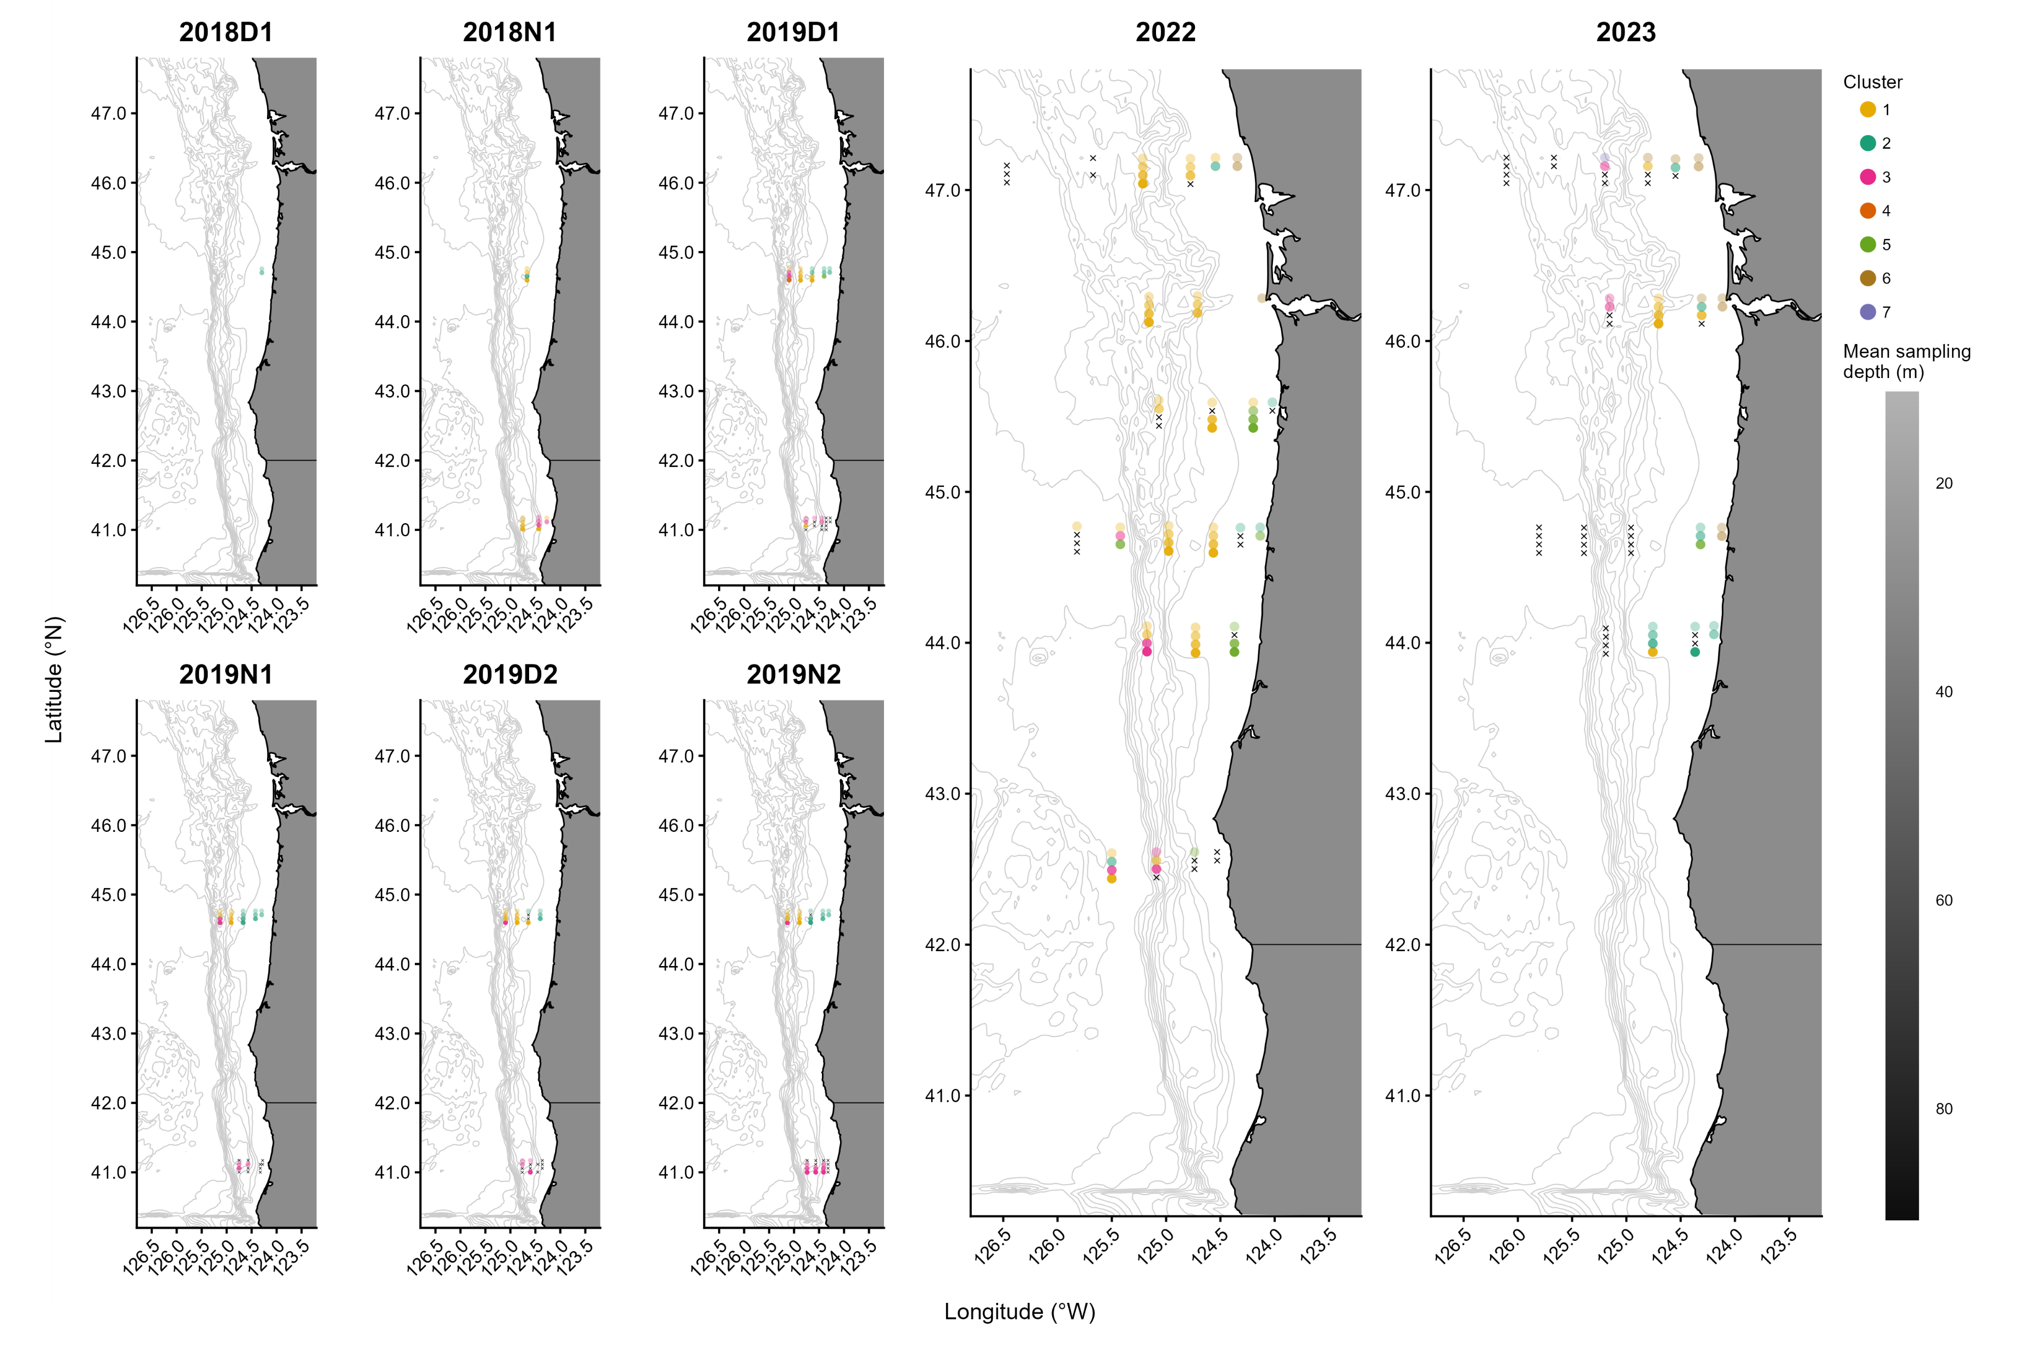
Cluster Distribution
Add fig 3 caption
Notes:
Discuss/point out major trends

Slide 11
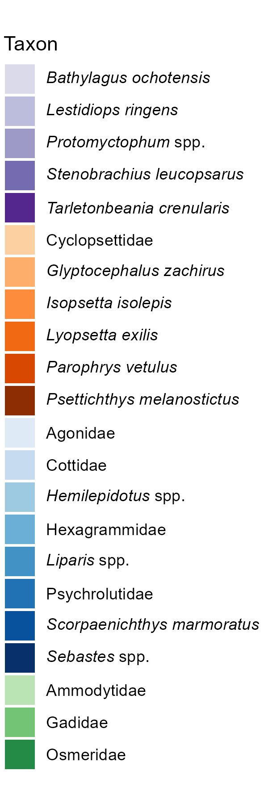
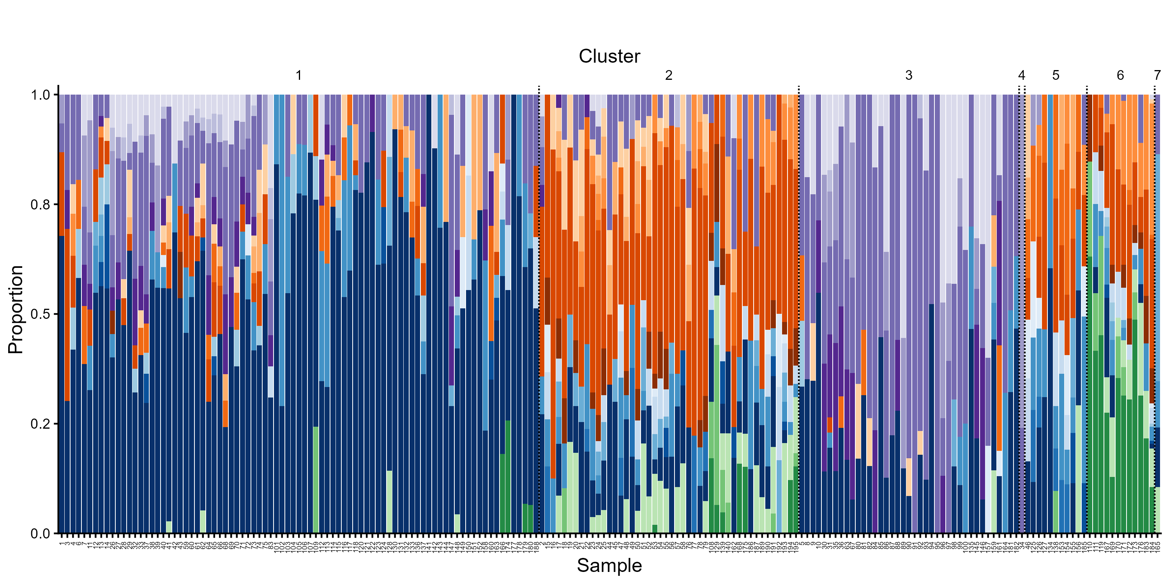
Cluster composition
Overview ISA results
Add fig 2A caption
Notes:
Establish the use of ISA to define representational taxa for each cluster. Mention single-sample clusters (4 and 7) and their subsequent exclusion. Overview major findings of fig 2A.

Slide 12
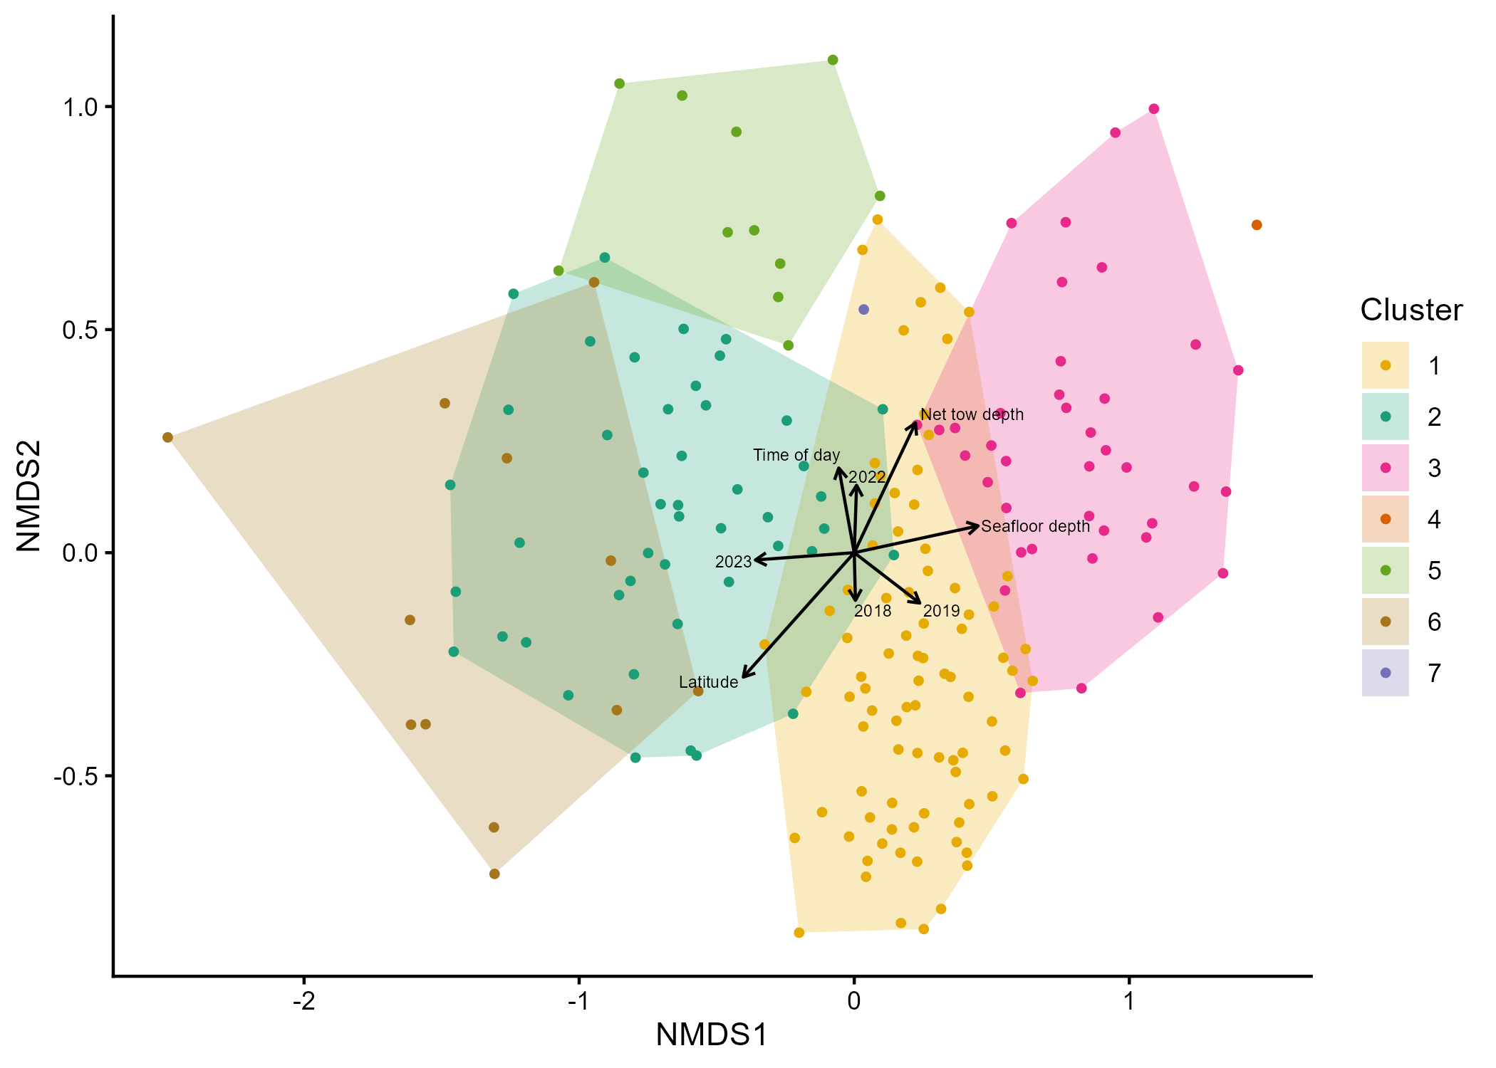
Cluster and spatiotemporal associations
Add fig 4 caption
Text outline of major take aways?
Notes:
More detail on associations seen, esp those that connect to cluster map

Slide 13
Db-RDA and VPA
Text outline of results (include p-values?)
Notes:
Spatiotemporal variables in base dbRDA model explain significant amount of variation in assemblage composition. Full db-RDA model also significant and explained a significant amount of ADDITIONAL variation in assemblage composition. Variance partitioning… 1.57% of variation in assemblage composition was explained by spatiotemporal and environmental covariates together, 3.72% by spatiotemporal covariates alone, and 1.92% by environmental covariates alone. The full model explained 8.78% of variation in assemblage composition and all of these amounts are statistically significant.

Slide 14
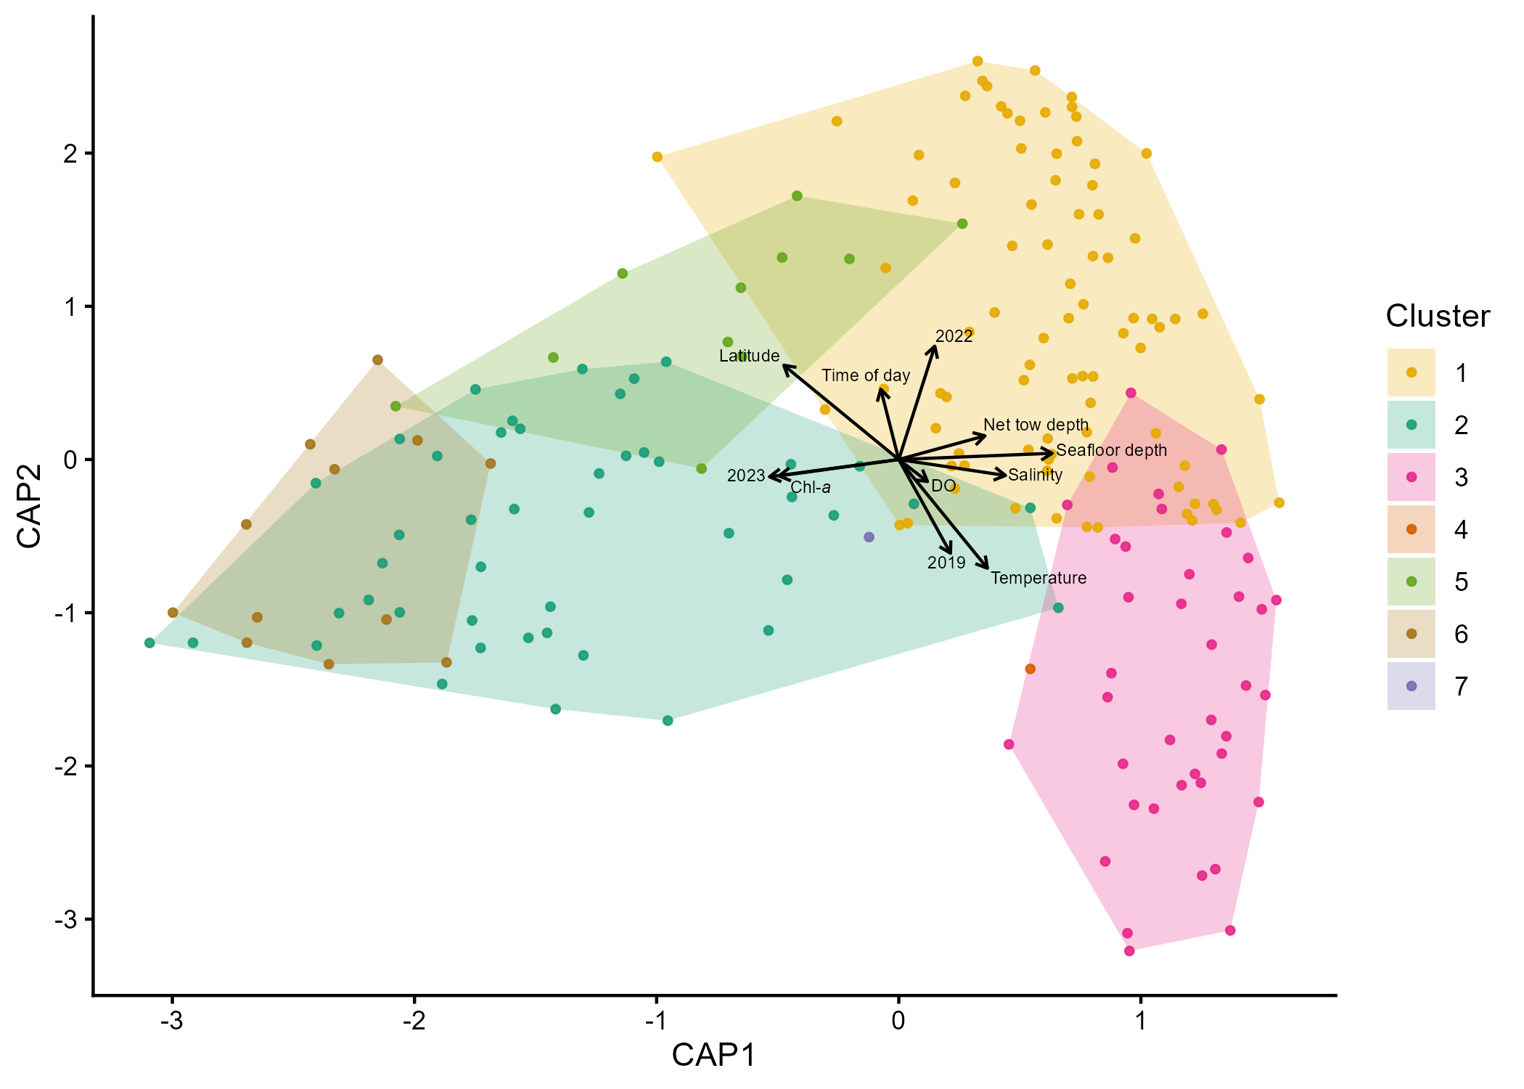
ANOVA of variables and model
Add fig 5 and caption
Mention ANOVA result – all covariates found to have significant effects on full dbRDA model
Text outline of major relationships in figure 5
Notes:
All covariates significant have significant effects in the full dbRDA model. Discuss effects as visualized on dbRDA plot especially those also seen in NMDS. Discuss potential correlations between covariates

Slide 15
Negative binomial GLMM
Not sure we’ll want this slide??
Discuss glmm and variables included. Perhaps include the representative equation?
Text outline of table S1?

Slide 16
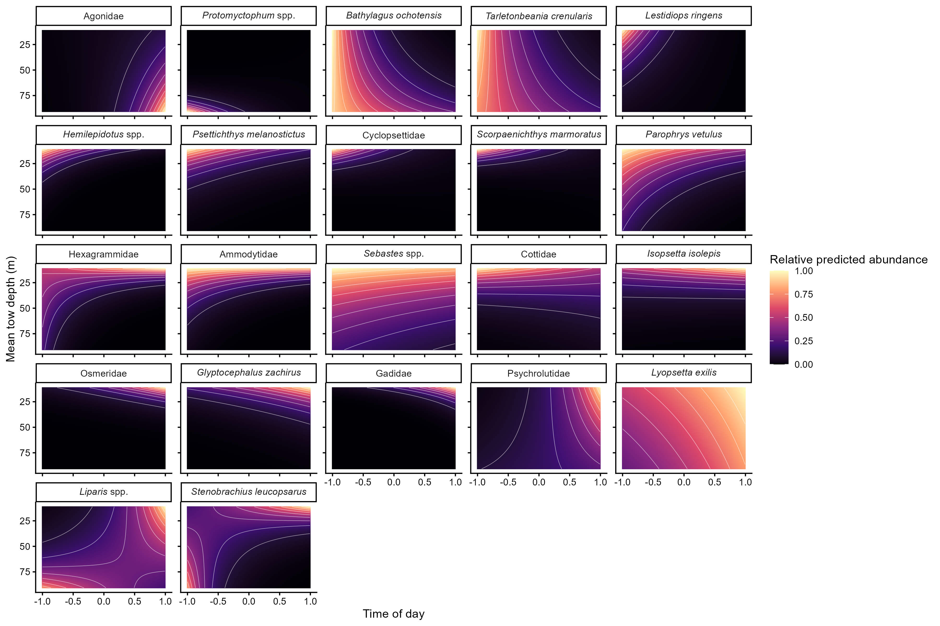
Taxon-specific vertical distributions
Add fig 6 caption
Text outline of patterns in predicted greatest abundance with depth and time of day
Notes:
Greatest predicted abundance…
During night at deepest depths AND during daytime at shallowest depths (Liparis spp., S. leucopsarus) (opposite of traditional/expected DVM behavior)
During day at deepest depths (Agonidae)
During night at deepest depths (Protomyctophum spp.)
During night across depths (B. ochotensis, T. crenularis)
During night at shallowest depths (L. ringens)
Across times of day at shallowest depths (Ammodytidae)
During day at shallowest depths (Osmeridae)

Slide 17
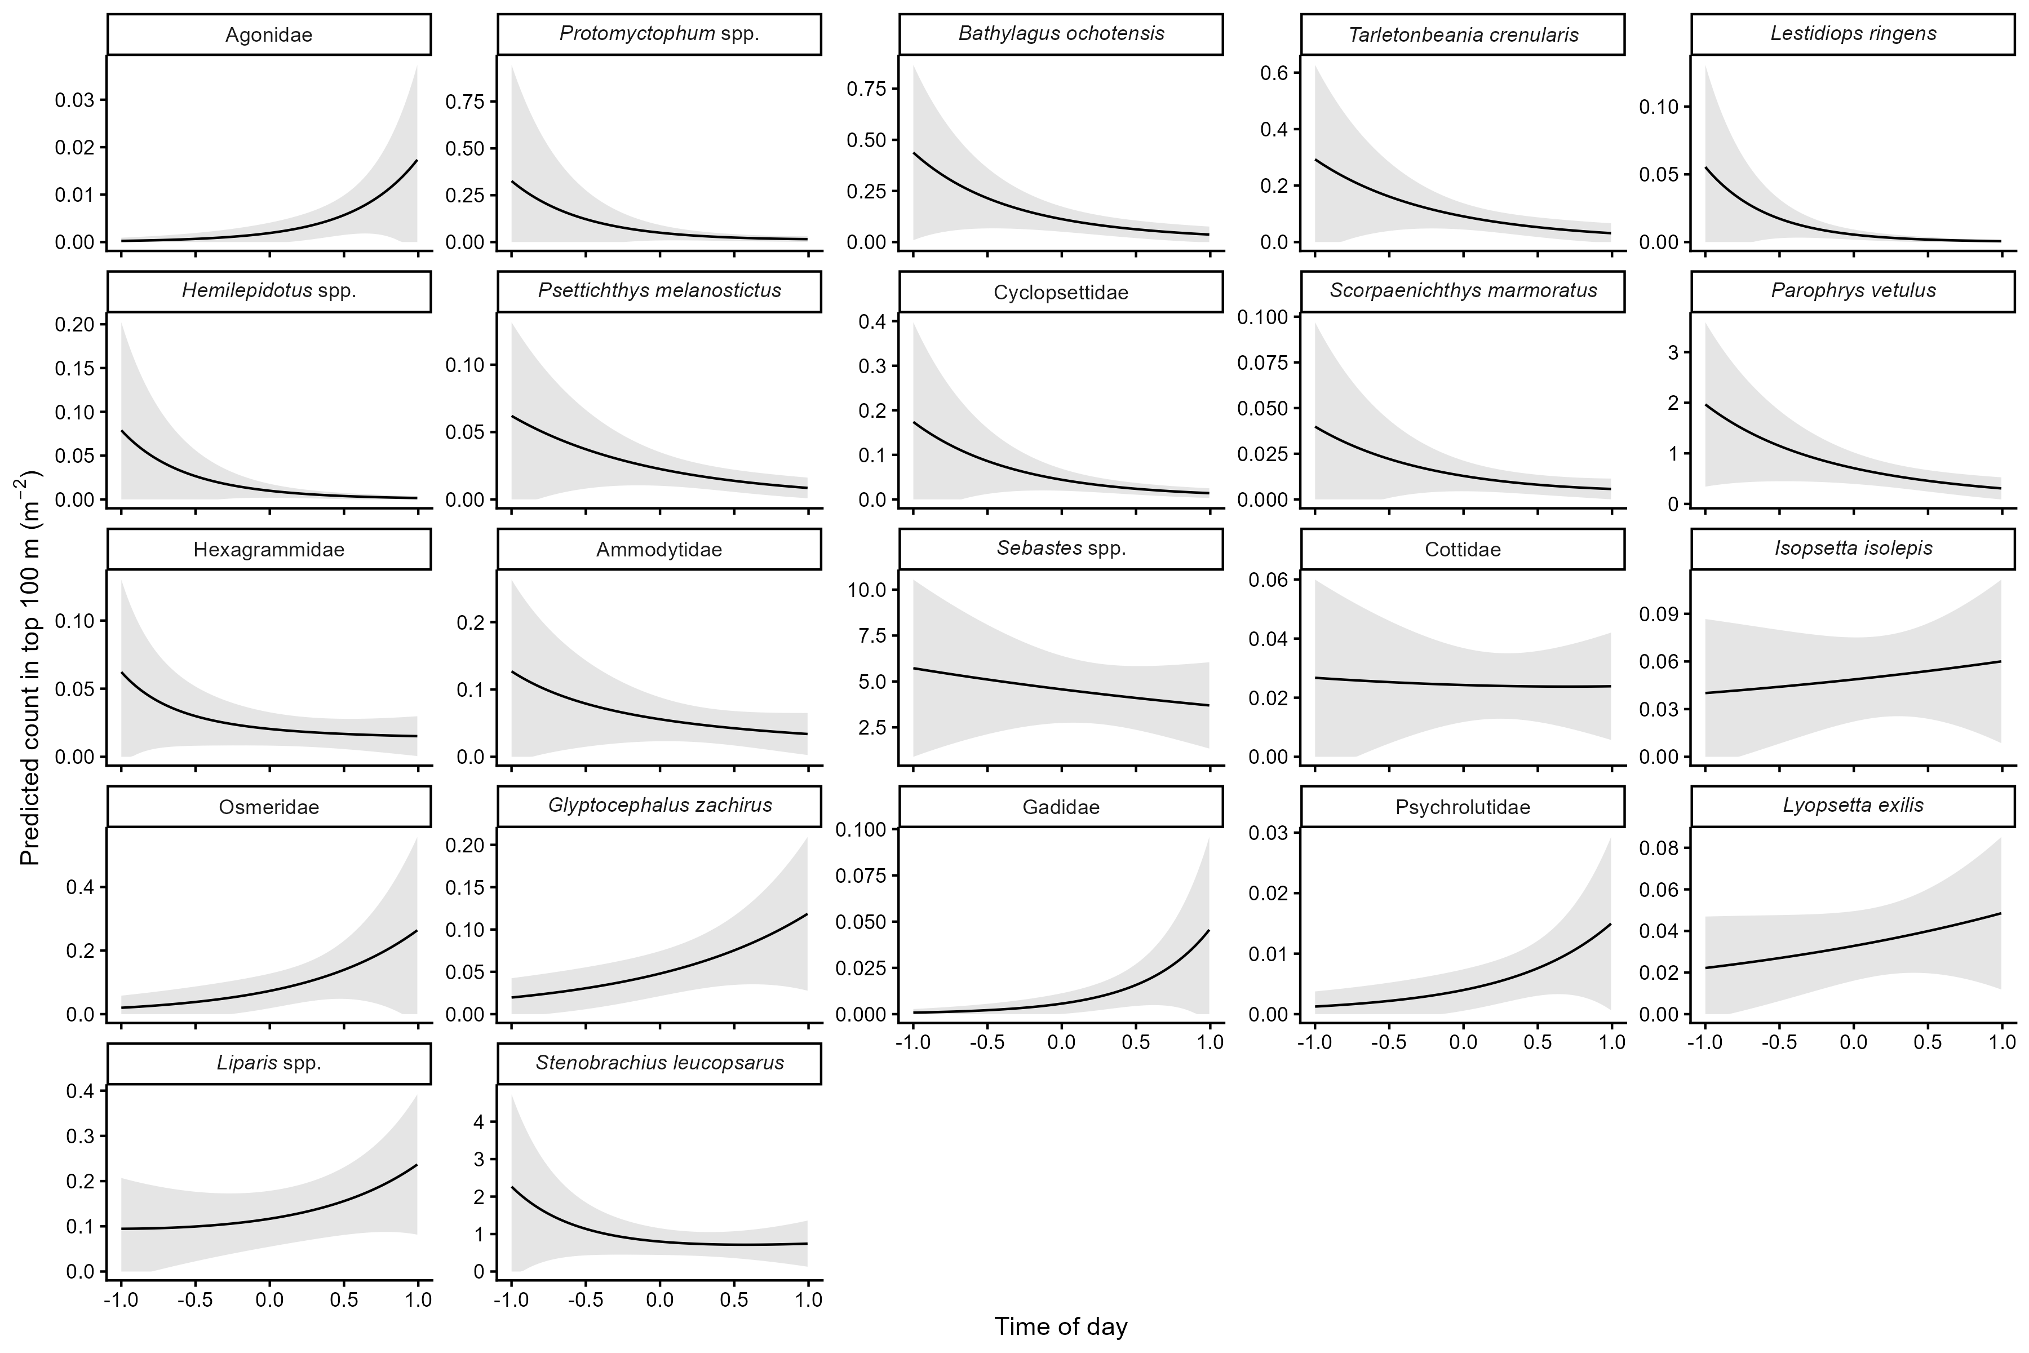
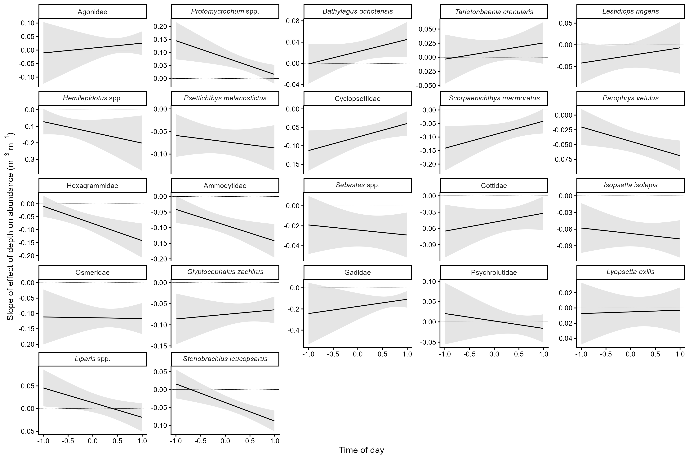
Time of day effects…
On total predicted abundance across depths
On depth-abundance gradients (slope)
Add fig 7 caption
Add fig 8 caption

Slide 18
Conclusions
Overview most important take aways

Slide 19
References
Add citations for any papers referenced in the previous slides (or do we include all that were in the paper?)

Slide 20
Thank you, Acknowledgements, and Questions

